Slide 1
AirBnb Analysis Capstone Project
Nevin Joshua Lyons

Slide 2
Problem Statement
The goal of my project is to provide insights and recommendations to optimize the Airbnb experience for hosts and guests in Seattle. By analyzing booking trends, pricing dynamics, neighborhood ratings, accommodation availability, and guest reviews, we aim to identify opportunities for hosts to improve their listings and for guests to make more informed booking decisions. Our objective is to leverage data-driven insights to enhance satisfaction, increase competitiveness, and foster growth within the Seattle Airbnb community.
This problem statement encapsulates the overarching objective of this data science project, which is to leverage the insights gained from analyzing the Seattle Airbnb dataset to drive actionable recommendations and improvements within the Airbnb ecosystem in Seattle.

Slide 3
Analytical Approach
CRISP-DM (Cross-Industry Standard Process for Data Mining) is a widely used methodology for conducting data mining and analytics projects.
It consists of six phases: Business Understanding, Data Understanding, Data Preparation, Modeling, Evaluation, and Deployment. This is how (below) how each phase of CRISP-DM was applied to my project analyzing the Seattle Airbnb data:

Slide 4
Business Understanding
In this phase, I have identified the business objectives and goals of the project. My main objective was to provide insights and recommendations to optimize the Airbnb experience for hosts and guests in Seattle. I aimed to leverage data-driven insights to enhance satisfaction, increase competitiveness, and foster growth within the Seattle Airbnb community.

Slide 5
Data Understanding
I managed to collect and explor the Seattle Airbnb dataset to understand its structure, content, and quality. This involved examining the various features such as booking data, pricing information, neighborhood attributes, and guest reviews. I have assessed the relevance and completeness of the data to determine its suitability for analysis.

Slide 6
Data Preparation
In this phase, I have cleaned and preprocessed the data to prepare it for analysis. This involved handling missing values, removing duplicates, and converting data types as needed. I also performed feature engineering to create new variables and transform existing ones to better represent the underlying patterns in the data.

Slide 7
Modeling
Modeling involved selecting appropriate analytical techniques to uncover patterns and relationships in the data. We applied various statistical and machine learning models to address specific questions and objectives, such as predicting booking trends, analyzing pricing dynamics, and identifying factors influencing guest satisfaction. For example, I have used time series analysis to identify the busiest time of the year, regression analysis to examine price changes, and sentiment analysis to analyze guest reviews.

Slide 8
Evaluation
In this phase, I have evaluated the performance of the models and assessed the quality of the insights generated. I used metrics such as accuracy, precision, recall, and F1-score to evaluate the predictive models. I have also considered the relevance, validity, and usefulness of the insights in addressing the business objectives.

Slide 9
Deployment
The final phase involves deploying the models and insights for use in practice.
And as so, the findings could be communicated through reports, presentations, or interactive dashboards for stakeholders to access and utilize.

Slide 10
Findings
1. Busiest Time of the Year and Price Changes:
We found that the summer months (June, July, August) are the busiest time of the year for Airbnb bookings in Seattle.
During peak periods, prices tend to increase, with the highest average prices observed in July.
2. Rent Distribution of Listings:
The distribution of rental prices across listings in Seattle is right-skewed, with the majority of listings priced below $200 per night.
3. Neighborhoods with the Highest Rating Review Scores:
Neighborhoods such as Magnolia, Queen Anne, and Madrona have the highest average review scores, indicating high guest satisfaction.

Slide 11
Findings 2
4. Highest Number of Accommodations by Neighborhood:
Downtown and Capitol Hill are the neighborhoods with the highest number of accommodations, offering a wide range of options for guests.
5. Neighborhoods with the Highest Prices:
Neighborhoods like Belltown and Pioneer Square have the highest average prices, reflecting their popularity and demand.
6. Chill Neighborhood:
Guest reviews mentioning terms like "chill" or "relaxed" indicate that neighborhoods such as Ballard and Fremont are perceived as laid-back and comfortable.

Slide 12
Findings 3
7. Review Based on Location:
There is variability in review scores across neighborhoods, with some neighborhoods consistently receiving higher ratings than others.
8. Most Common Type of Accommodation Used in Seattle:
Entire home/apartment listings are the most common type of accommodation used by guests in Seattle, followed by private rooms and shared rooms.
9. Analyzing Guest Reviews:
Guest reviews provide valuable insights into the guest experience, highlighting aspects such as cleanliness, location, and host communication.

Slide 13
Appendix

Slide 14
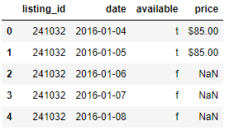
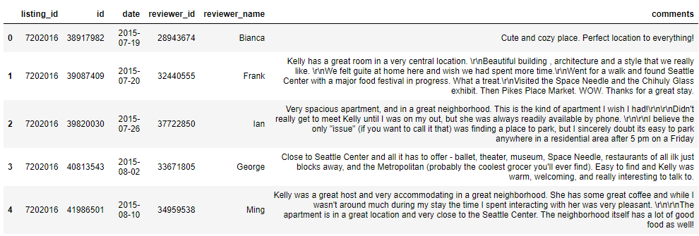
Loading my DataSets
calendar = pd.read_csv('calendar.csv')
listings = pd.read_csv('listings.csv')
reviews = pd.read_csv('reviews.csv')
Note – use APA style referencing for in-text citations (refer to link above)

Slide 15
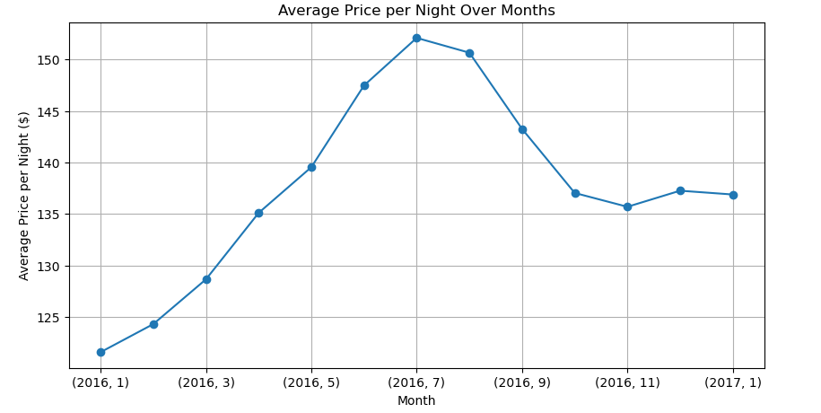

Slide 16
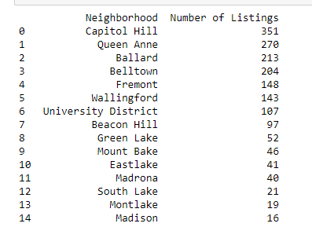

Slide 17
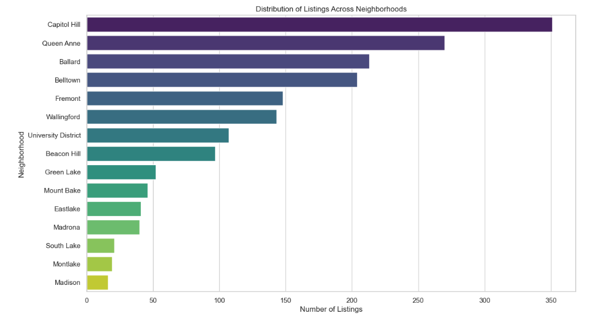

Slide 18
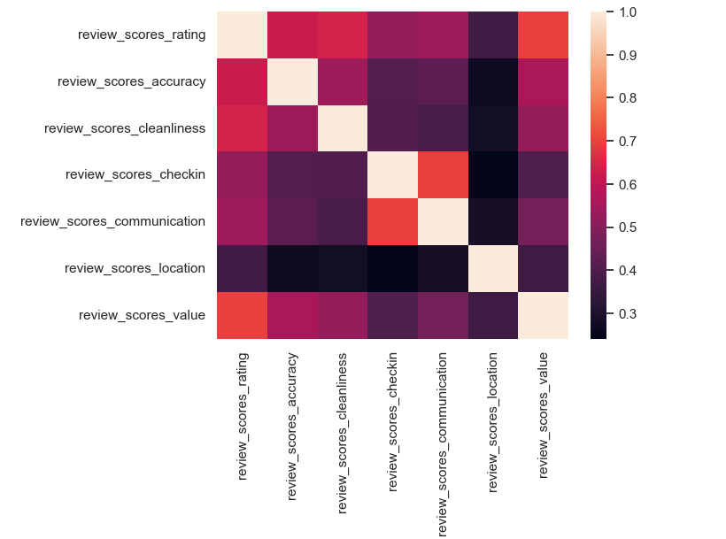

Slide 19
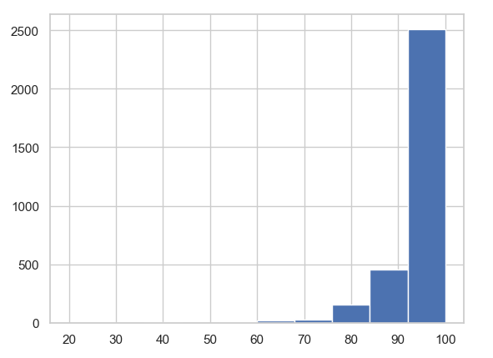
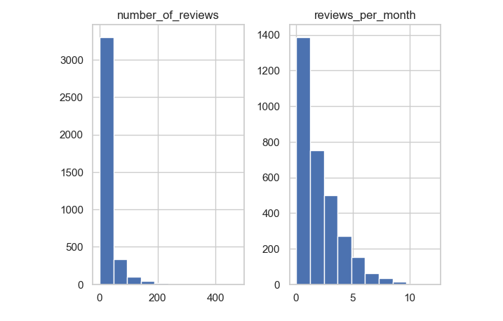
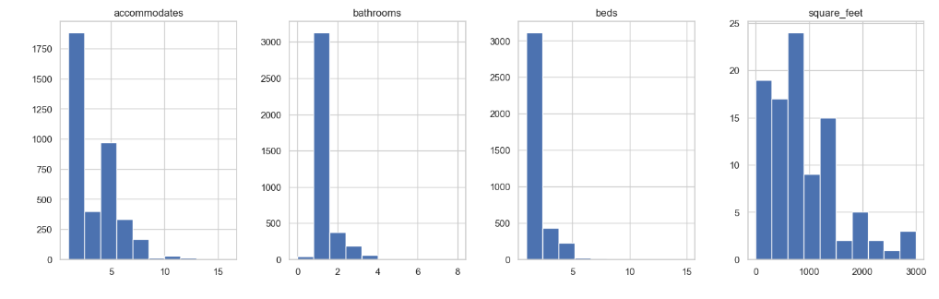

Slide 20
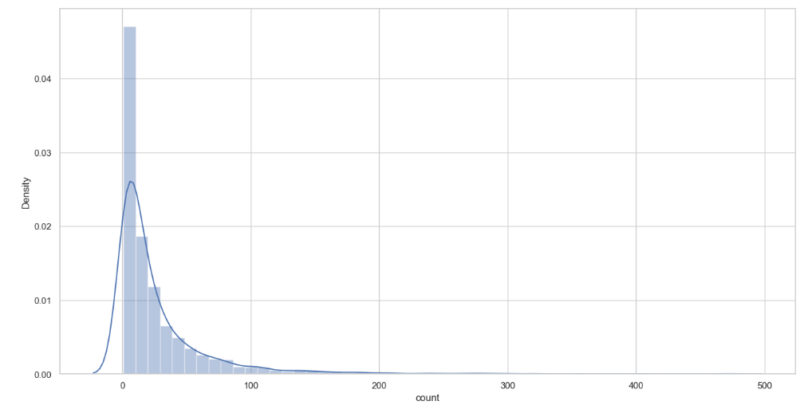
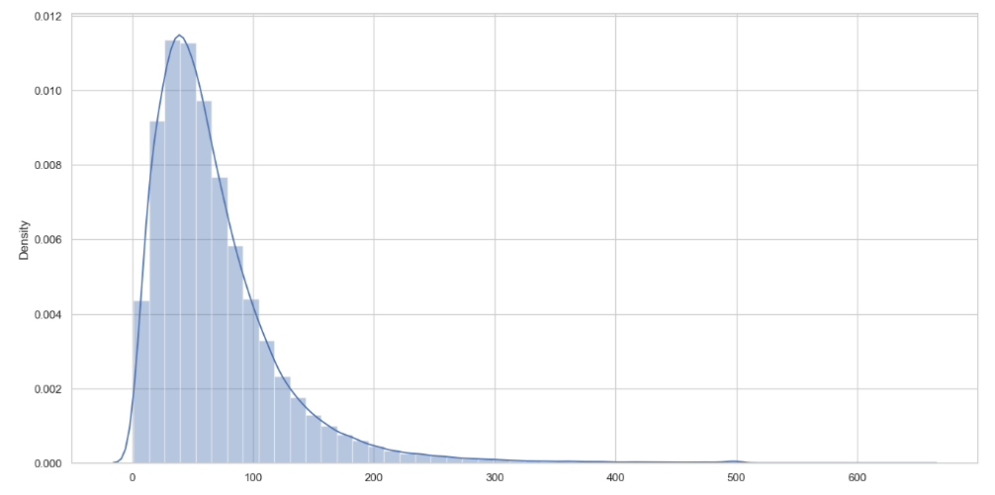

Slide 21
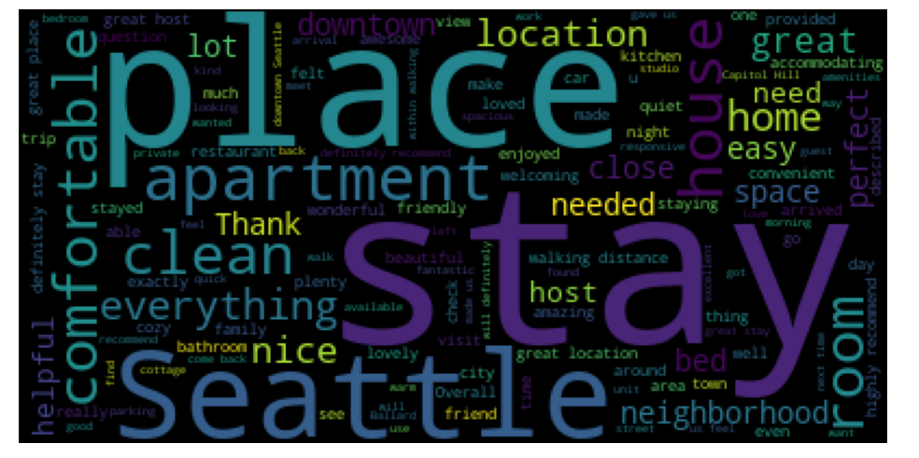

Slide 22
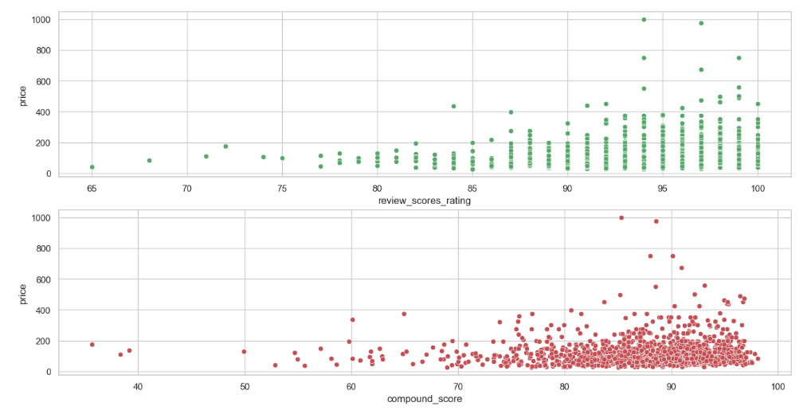

Slide 23
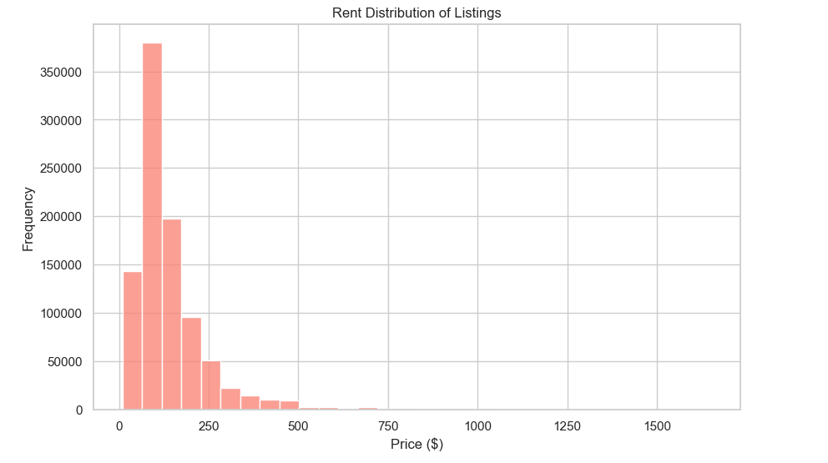
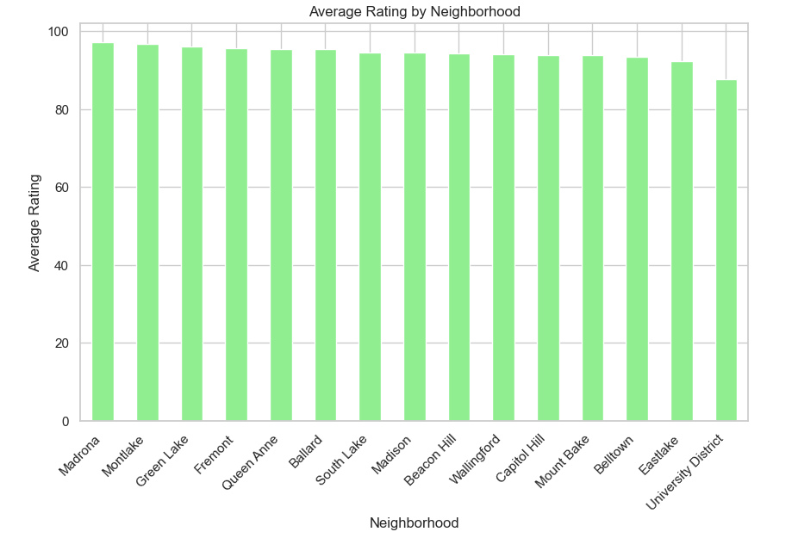

Slide 24
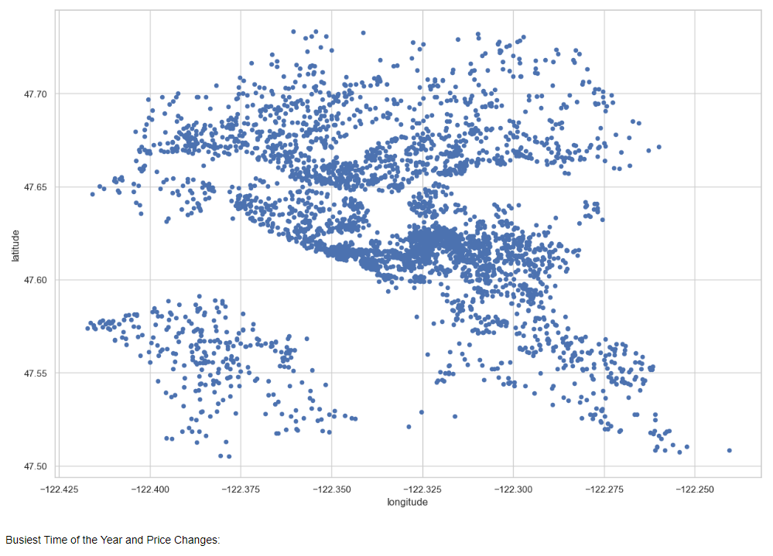
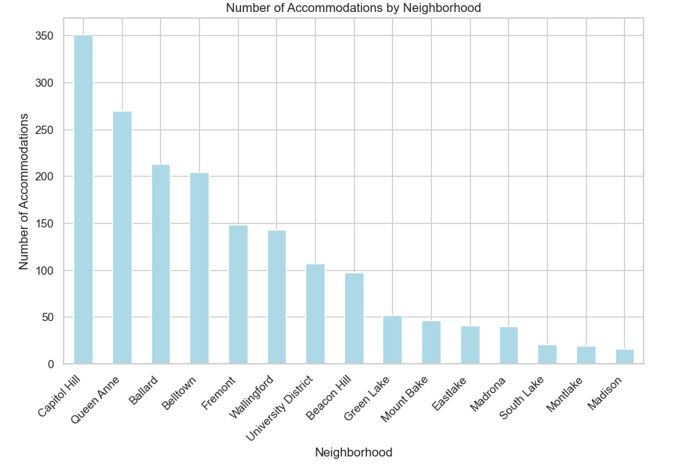

Slide 25
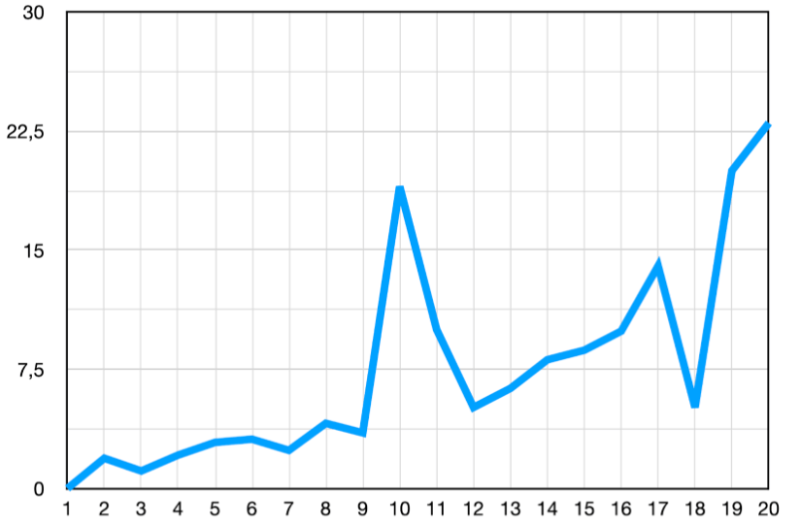
Sub-Title 2
Table 1. Table title
Figure 1. Chart title

Slide 26
Reference
Use latest APA style referencing
https://libguides.nus.edu.sg/APA/intext

Slide 27
Thank you

